Slide 1
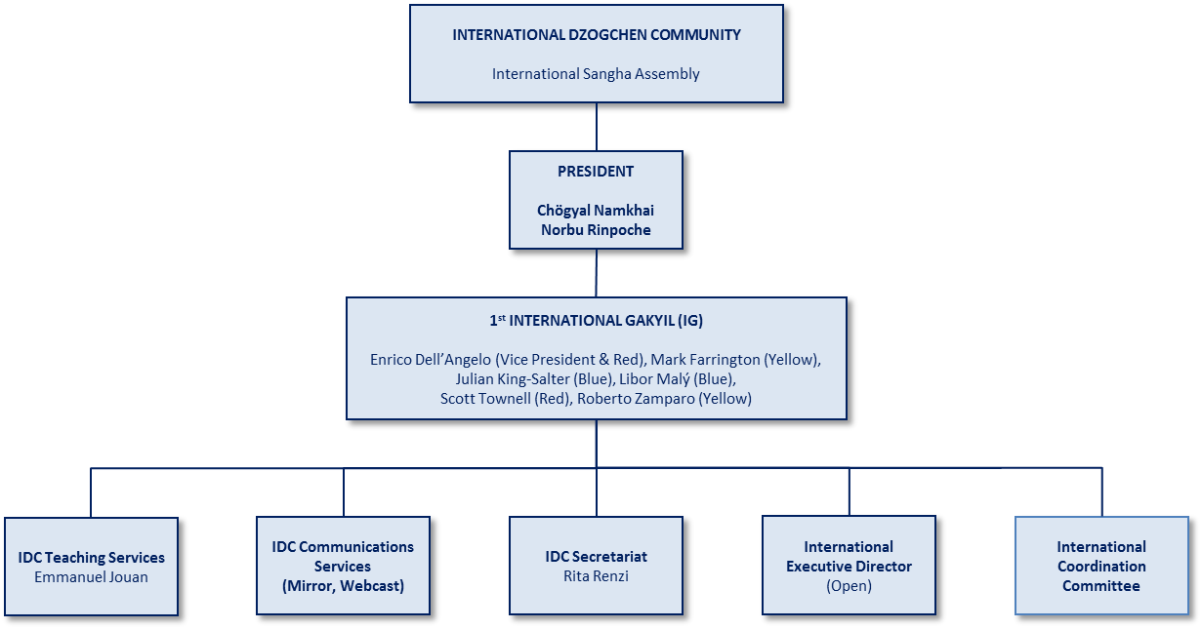
International Dzogchen Community (IDC)

Slide 2




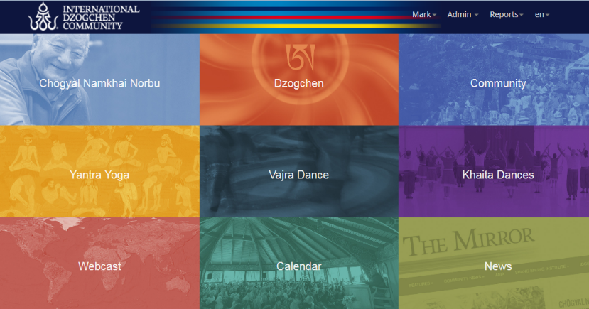
Our Community
IDC = Unified membership and formal, legal alignment
Rinpoche’s Longsal symbol as authentication of pure Dzogchen Teachings
A single Website to access all information
Webcast to unify all students globally with the Master
The Mirror as a global source of information, news and updates

Slide 3
International Gakyil Mandate for 2015
Set up the integrated, functional network of the International Dzogchen Community
  Align gars and lings with IDC
  Establish basic operational systems and processes
  Enable communications
Provide basic services and governance
  Membership
  Copyright and Trademark
  Legal and financial (for IDC)
  Webcast
  The Mirror
  Web Portal
  International Teacher administration

Slide 4
IDC Membership Highlights for 2014
Surveys conducted on global pricing & benefits for membership October & November
New Global Membership tiers and pricing announced December
New online Membership Management System (MMS) launched from December
Current number of Gars & Lings set up on MMS: 10 Gars, 45 Lings
Number of members globally for 2013 was estimated to be 6,100
Our expectation from last year was for 8% membership growth. Rinpoche’s busy schedule, regular Webcasts and the new online MMS will help to achieve this expectation
Rinpoche taught in India, Bhutan and mainland China in 2014, creating potential for new members
2013

Slide 5
Welcome Cards
Welcome Cards are to allow for new students to participate in Dzogchen Community activities for at least three consecutive years before becoming a member, and assuming all of the associated responsibilities / privileges of a member, such as:
  Take SMS exams
  Become Gakyil member
  Be Gekod
  Vote at AGMs
Welcome Card holders are given access to Webcast Teachings, use of the Webcast Replay System and can participate in the study and practice of Base Level Santi Maha Sangha. Other discounts and benefits are set according to the level of Welcome Card donation and the commensurate offers made by local Gakyils.
Continuity of membership is an important part of maintaining the Dzogchen Community. As a result, for those students that have allowed their membership to expire without renewal may be asked to restart the three year Welcome Card process in order to re-establish membership status or to pay missing years. If you have inadvertently missed your membership renewal, please contact your local Gakyil to address your membership status

Slide 6
Communications: What Works and What Doesn’t?
What methods of communication does your local community use? How effective are they?
What communications-related issues does your local community have?
What solutions have been tried? What has worked best?
How are we (the IG) doing with communication?
  What has been effective?
  How might we improve communications?
Importance of keeping community and personal Gakyil email addresses updated in MMS to reach the Gakyils
Please respond by email to blue@dzogchen.net

Slide 7
International Teacher Management Update
Update:
  Essential centralized service of the IDC from July
  Discussions currently underway on how to best formulate the service
  More news mid-year
Questions to think about (please respond via e-mail to blue@dzogchen.net) :
  How does your local community use the International Teachers?
  What about local or regional teachers?
  How can the IG help you with International Teacher Management?

Slide 8
President’s Message
“As you know, at the moment I am making many necklaces; it is useful for relaxing and also for making money for the Gonpa. I did not go to college to learn how to make necklaces – I went to college to learn how to think for myself.
So then I observed, and worked out the best way. Now I have systems for making each type of thing, necklace, bracelet, car and moto protections, and it becomes easy.
It is the same for our Community, we need some systems so that everything becomes easier to carry out. We observe, we apply, and work out the best way to do everything.
So I hope all our Gakyils and members can collaborate very well, so that our Dzogchen Community can carry on into the future in the best way.”
-- Namkhai Norbu
given at Dzamling Gar
April 2015

Slide 9
Status of 2014 Strategic Priorities
Strategic Priority | Status as of 31 December, 2014
Build and Implement a DC Portal | Basic Functionality Real integration to be implemented Improvement in Progress
Build and Implement an Online Membership Database System | Complete as Originally Specified Development Underway for Additional Functions
Achieve Alignment of Existing Gars & Lings with IDC | Some Progress – continues through 2015

Slide 10
Proposed IG Priorities for 2015 (revised)
 | 1. Continue to encourage alignment of gars and lings with IDC | 2. Encourage expansion of IDC membership | 3. Continue to develop the IDC Internet portal | 4. Establish foundation for greater fundraising efforts at the IDC level | 5. Make adequate preparations for handoff to the 2016-2019, 2nd International Gakyil | 6. Deliver Valuable Ongoing Services to IDC Membership
DESCRIPTION | Encourage all remaining non-aligned gars and lings to complete the alignment process. | In coordination with the alignment process, expand IDC membership to include all members of the legacy Dzogchen Community and begin to address their membership needs. | Implement a web presence that is capable of integrating all Dzogchen Community web services into a common environment for community information and collaboration. | Develop fund raising strategies that operate in concert with planned IDC expenditures, and build fund raising architecture for multiple donor channels. | Self explanatory. | Ensure that all administrative and Member Service activities are delivered in an effective manner and at realistic costs. Continually improve service delivery products, methods and outcomes.
IG LEAD | Red (Enrico) | VP/Yellow/Blue | Blue | Yellow | Red | IG Secretariat
SUPPORTING INITIATIVES | Continue the process as it is currently designed. | Begin to handle membership administration tasks for more members. Evolve the online membership management system and related database to the next level of sophistication. | Conduct appropriate background research. Requirements Gathering Consensus Building Design & Development Testing Deployment | Use of web portal to increase general fund raising Webcast trailer project Establish Foundation Establish protocol for bequest and estate management | Map process flows Complete all legal and policy documentation Identify and document operational improvements for later action. Plan and conduct a General Assembly meeting to elect the new IG members. | Business-as-Usual activities Technical Support IDC Communications Services IDC Teaching Services

